Slide 1
Hackathon
Finance Guide Web-App

Slide 2
Team name and member details
Aditya Sharma ( github:- https://github.com/Aditya-aot/Hackathon-ION )
Project link :- https://finance-guide.herokuapp.com/
Github link :- https://github.com/Aditya-aot/Hackathon-ION
Theme Name: Theme1, Fintech

Slide 3
Solution
Explain, in brief, how you intend to SOLVE the problem at hand.
Please include the following:
How it helps to solve the problem?
> in this webapp there is a section call guide, in which you can get information in detail about finance,stock market,crypto market , real estate and more . and see videos on diffrent topic to your likeing .
> and you can another section called predic , in which you can see the prediction for future stock market, for example :- you predict a singel day of any stock ,or can view a chart of any stock from 10 days to 500 days in future
> there is also section called portfolio in which you can create your portfolio in stocks and in crypto market and keep track of your profit and loss
> and last but not lest the section called News , in which you can get the latest news about finance in a single tip and get acces to manay information about finance

Slide 4
Frameworks/Technologies stacks to be used
There is use of Python
Django(framework)
Random Forest Model(Machine Learning)
Yfinance
Jupyter Notebook

Slide 5
Assumptions, constraints, and solution decision points (Reason behind choosing a technology)
The constraints in this webapp is to understand the flow to finamce in 2021 and how to present it to the users
And from where to get the data of stock so, we tried webscraping , api , and more but at last we used yfinance library to get raletime stock data
We try many machine learning algorithm to see which fit our requirement and in last we choice random forest algorithm
And to show the result of prediction on screen

Slide 6
How easily can your solution be implemented and how effective will it be?
Now the internet is access to every one and it is easy to use the webapp
And in guid section all of the topic are explained in text and as well as in videos .
Most of the videos on this web is on youtube as it gives creators opportunity to share there knowleage to guid in finance
Just in one click you can access the webapp and get information about finance

Slide 7
Extent of Scalability/Usability
The web can expand even more with more features
As there are even more topic , task, management , future guid and more in finance which can be implemented in this webapp very easy
We can also expand and explain even more topic .

Slide 8
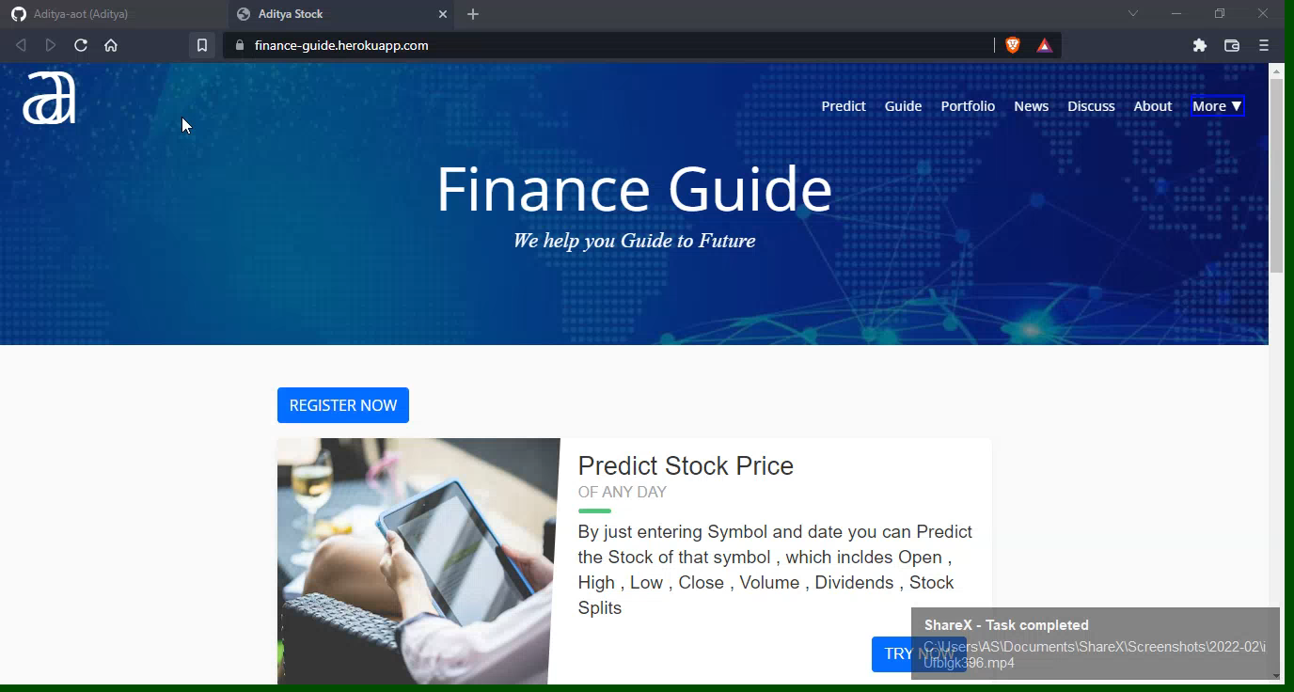
Prototype video

Slide 9
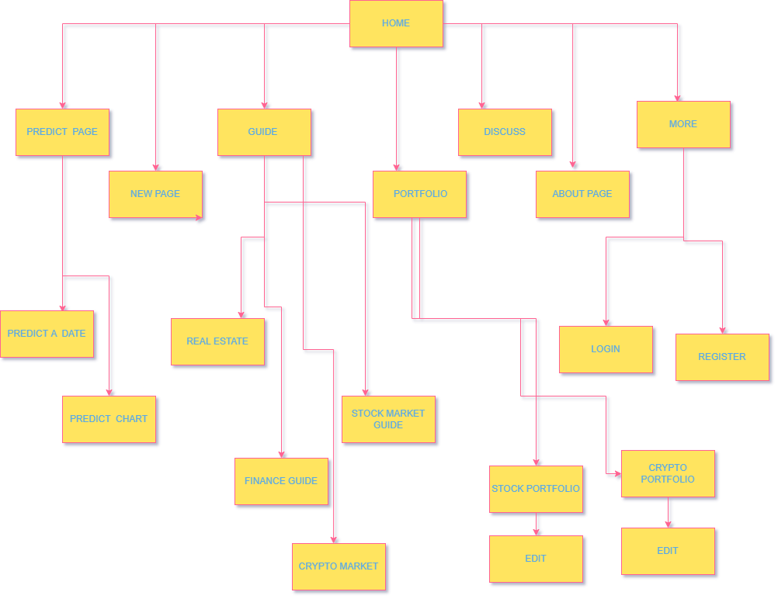
Architecture diagram

Slide 10
Future Scope
Business relevance
AS in business we can use this webapp in multiple countries
Optimization
many expert can also use the app to share there knowledge is the site
Scope for modification
There is ultimate scope for modification as the Education industry is expanding day by day
Societal Impact / Novelty
For society to get an financial education or tools can be easy in online

Slide 11
Thank You

